Slide 1
Scouting and Radio
KE8AQW

Slide 2
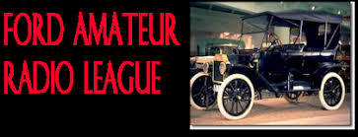
About me
Licensed in 2015
Eagle Scout 2010
W8AXZ Trustee
Ford Amateur Radio League President

Slide 3
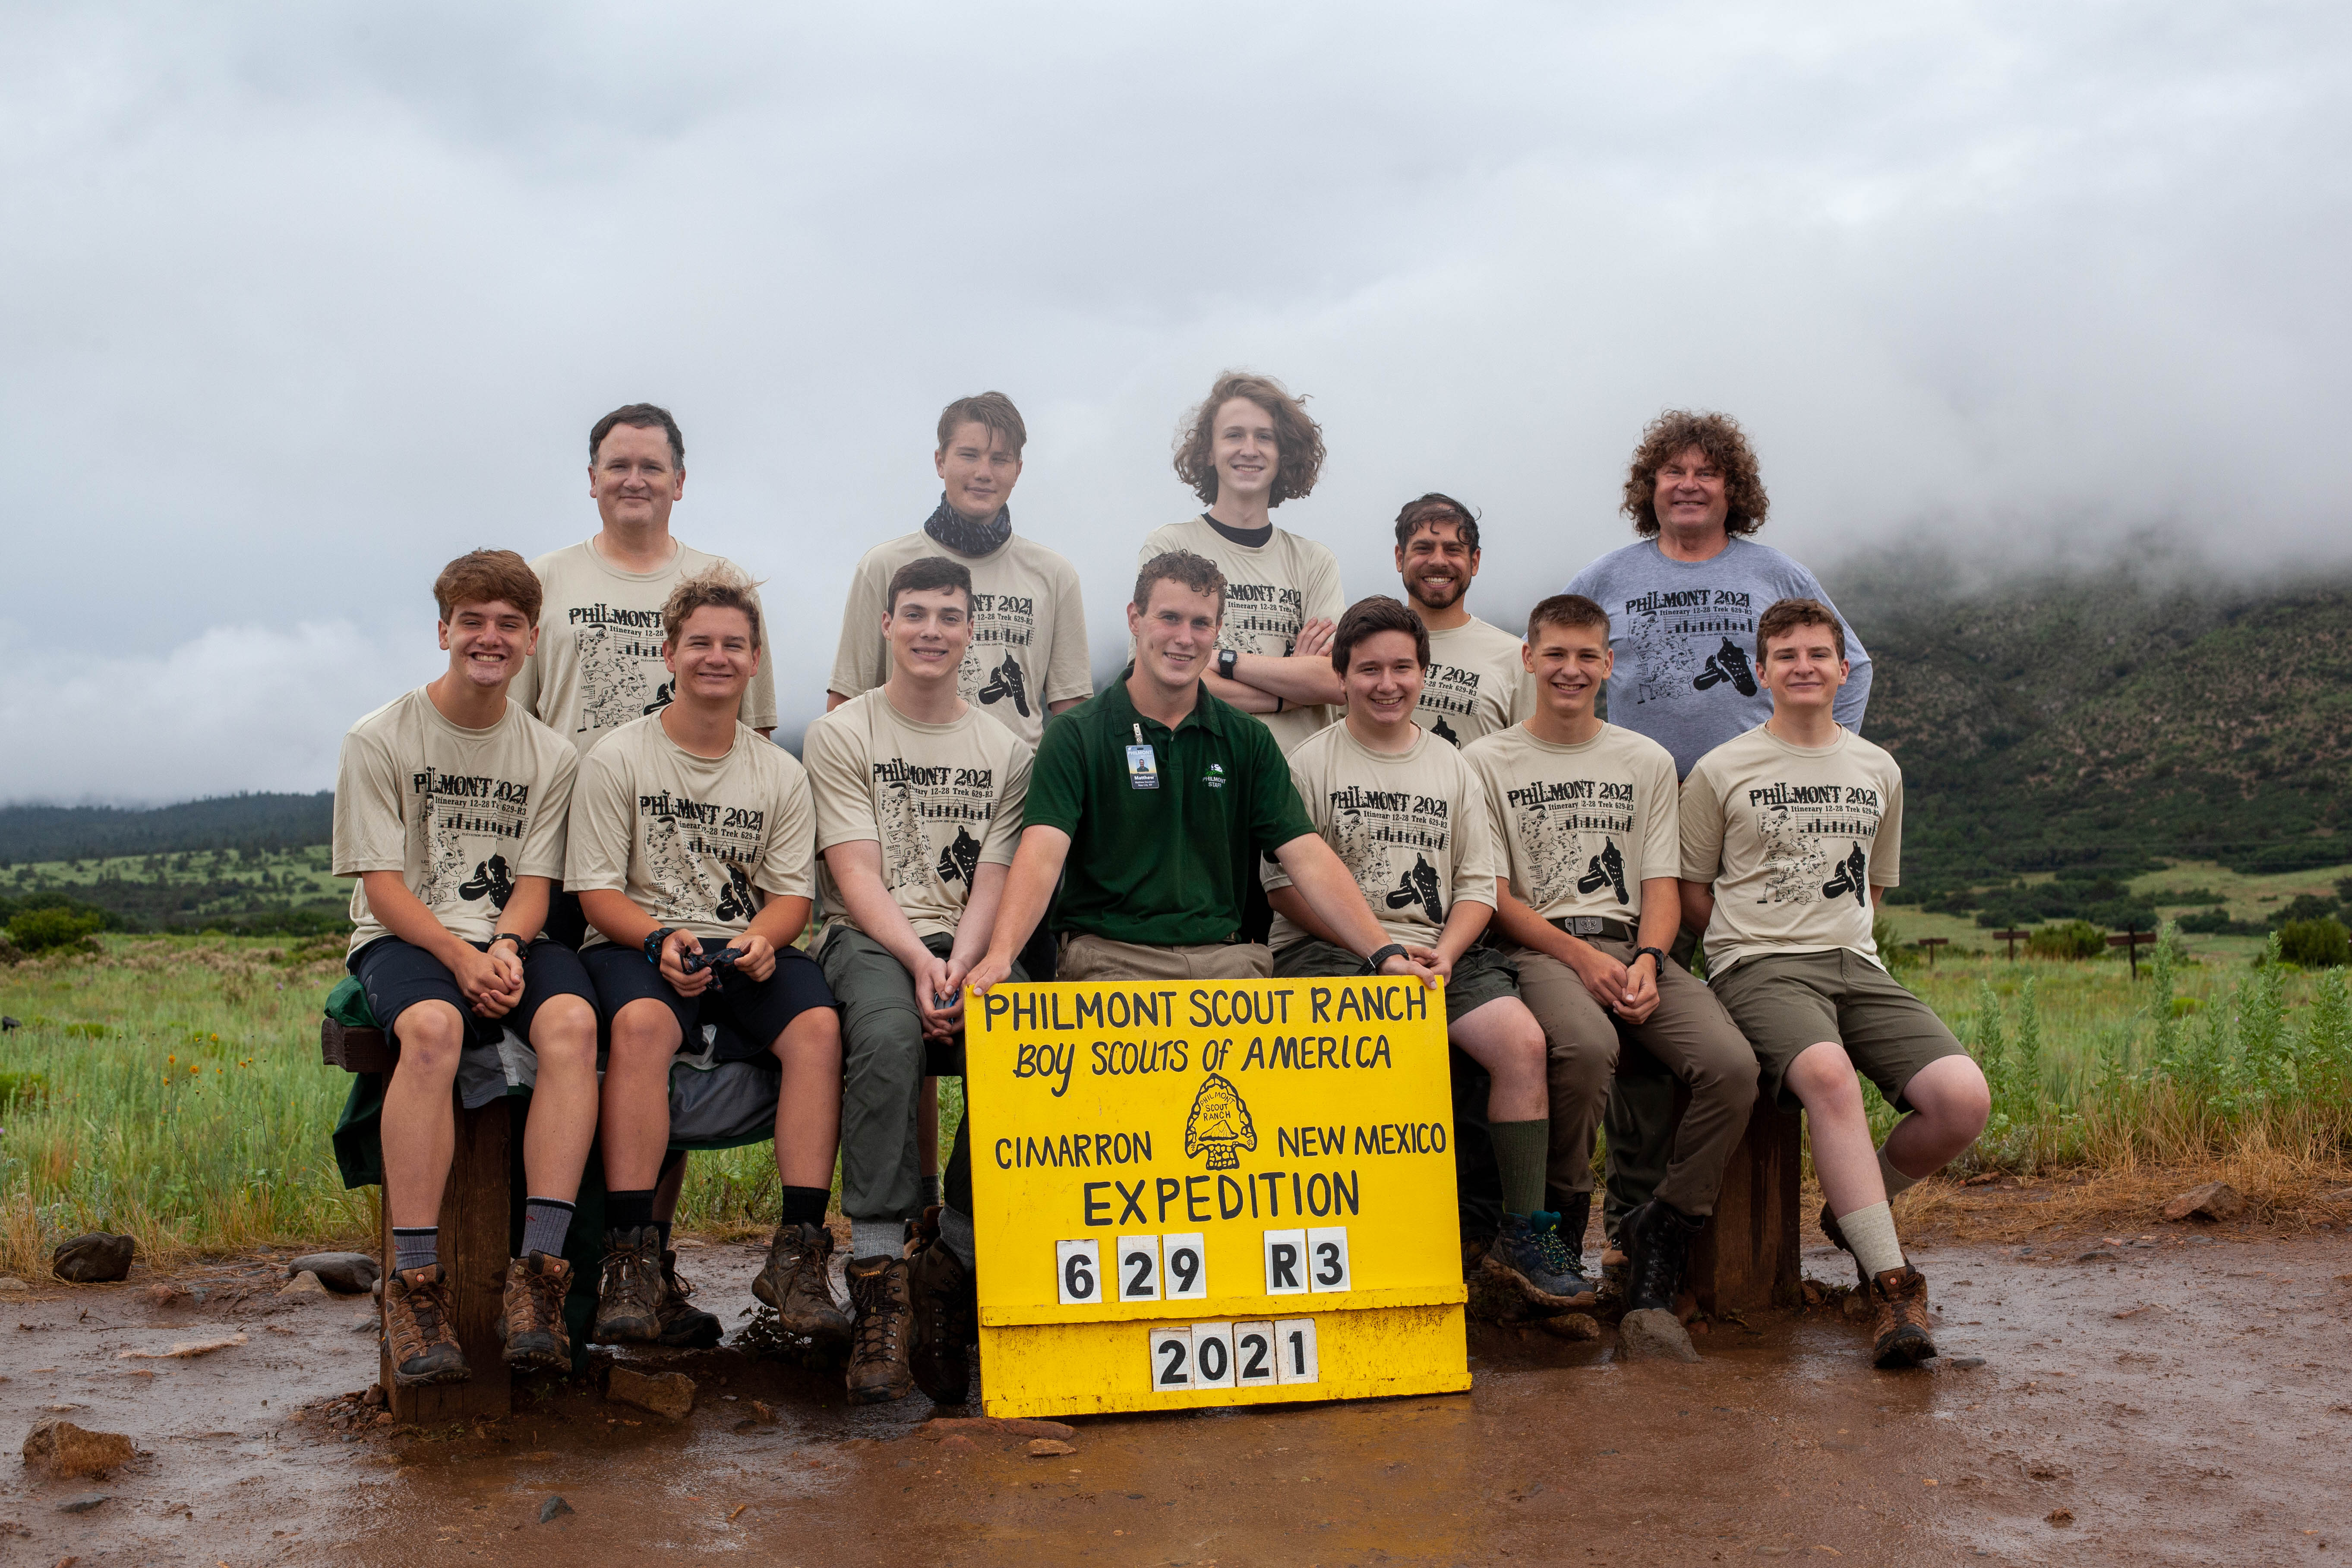
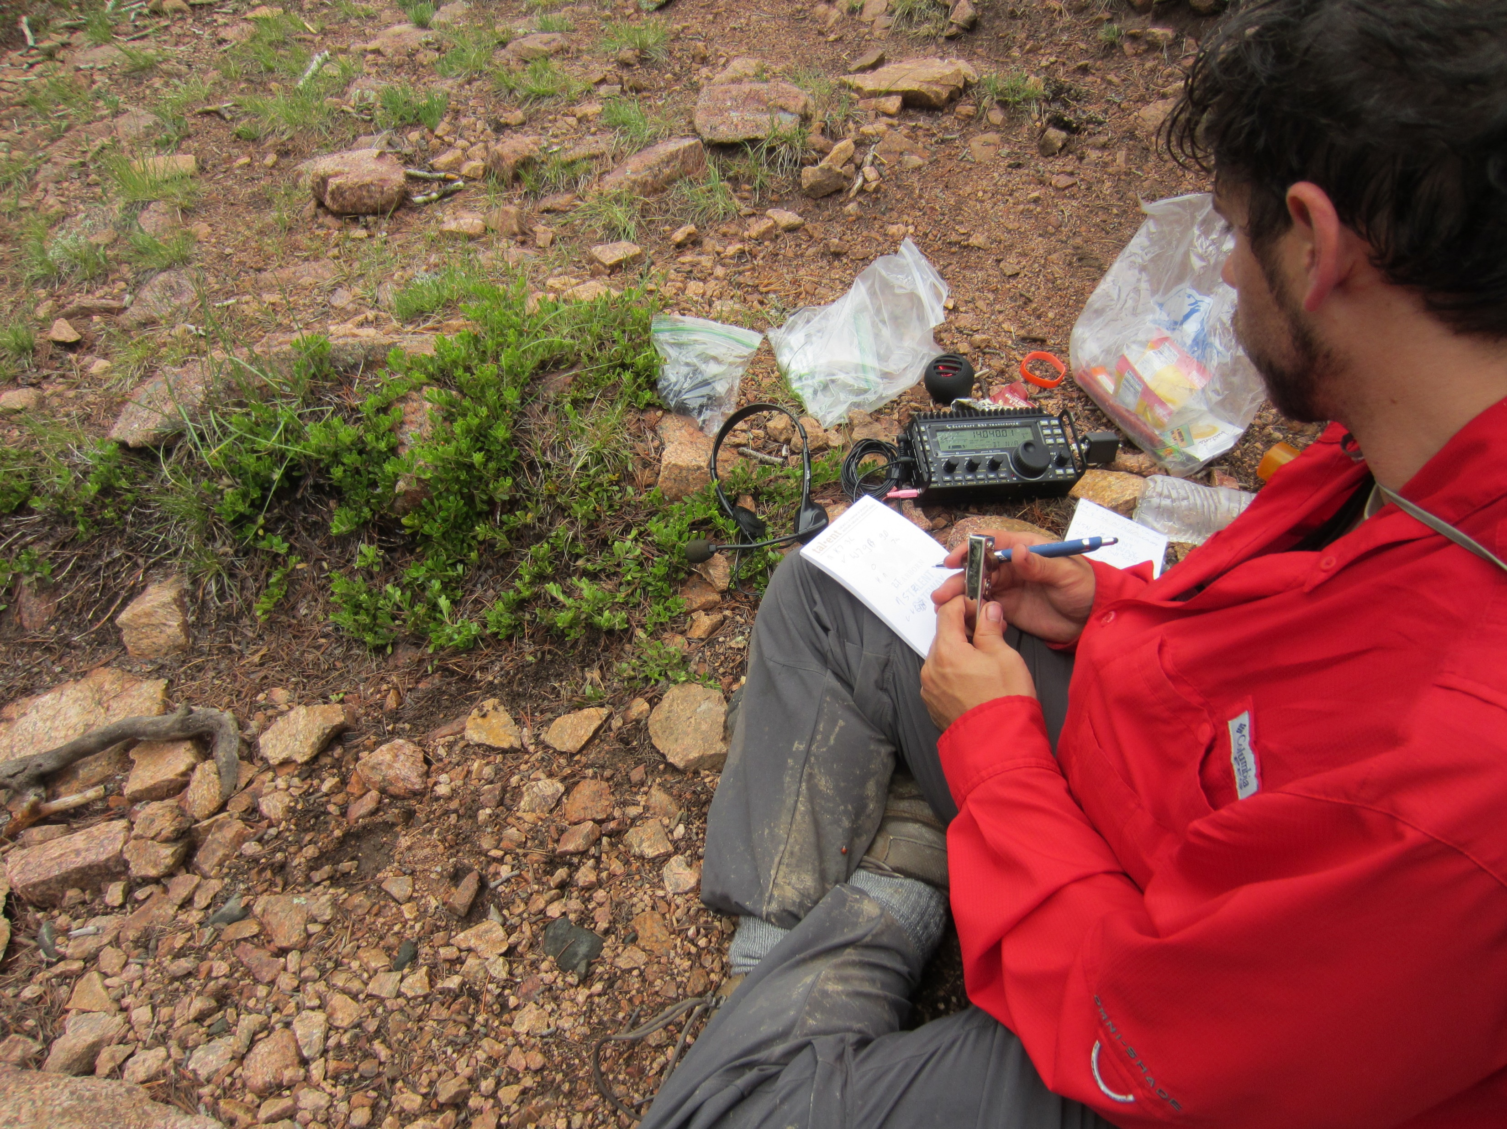
Philmont Scout Ranch - SOTA

Slide 4
Philmont Scout Ranch - SOTA

Slide 5
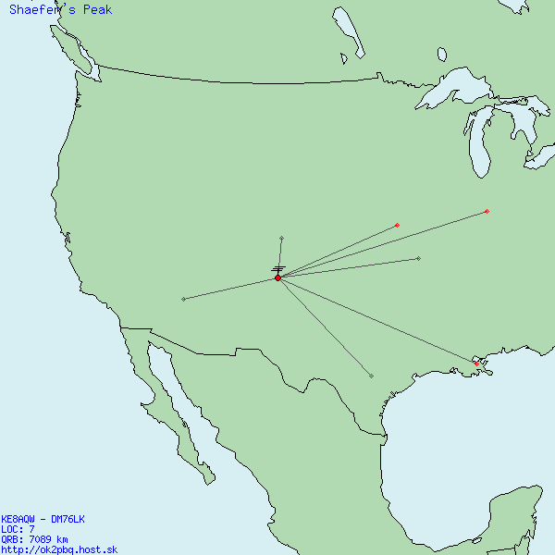
Philmont Scout Ranch - SOTA

Slide 6
Philmont Scout Ranch - Philmont

Slide 7
National Jamboree
Summit Bechtel Reserve – WV
~9,000 scouts ~14,000 total participants & volunteers
July 19-28th

Slide 8
National Jamboree

Slide 9
National Jamboree

Slide 10
National Jamboree

Slide 11
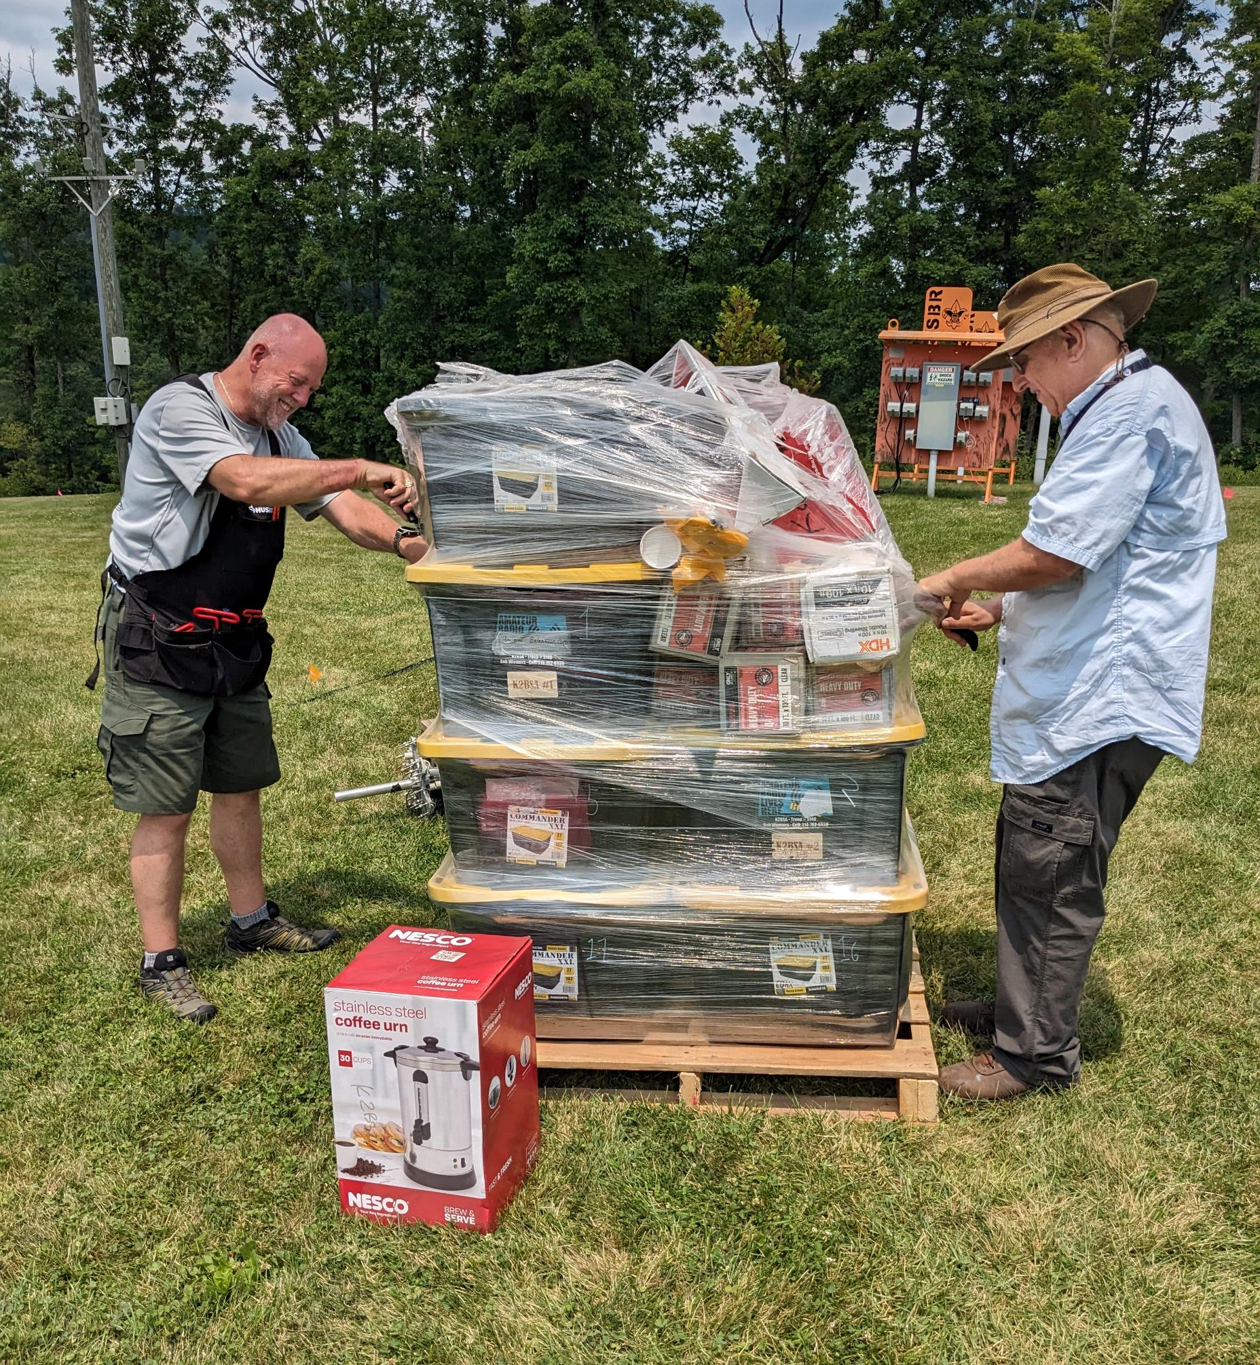
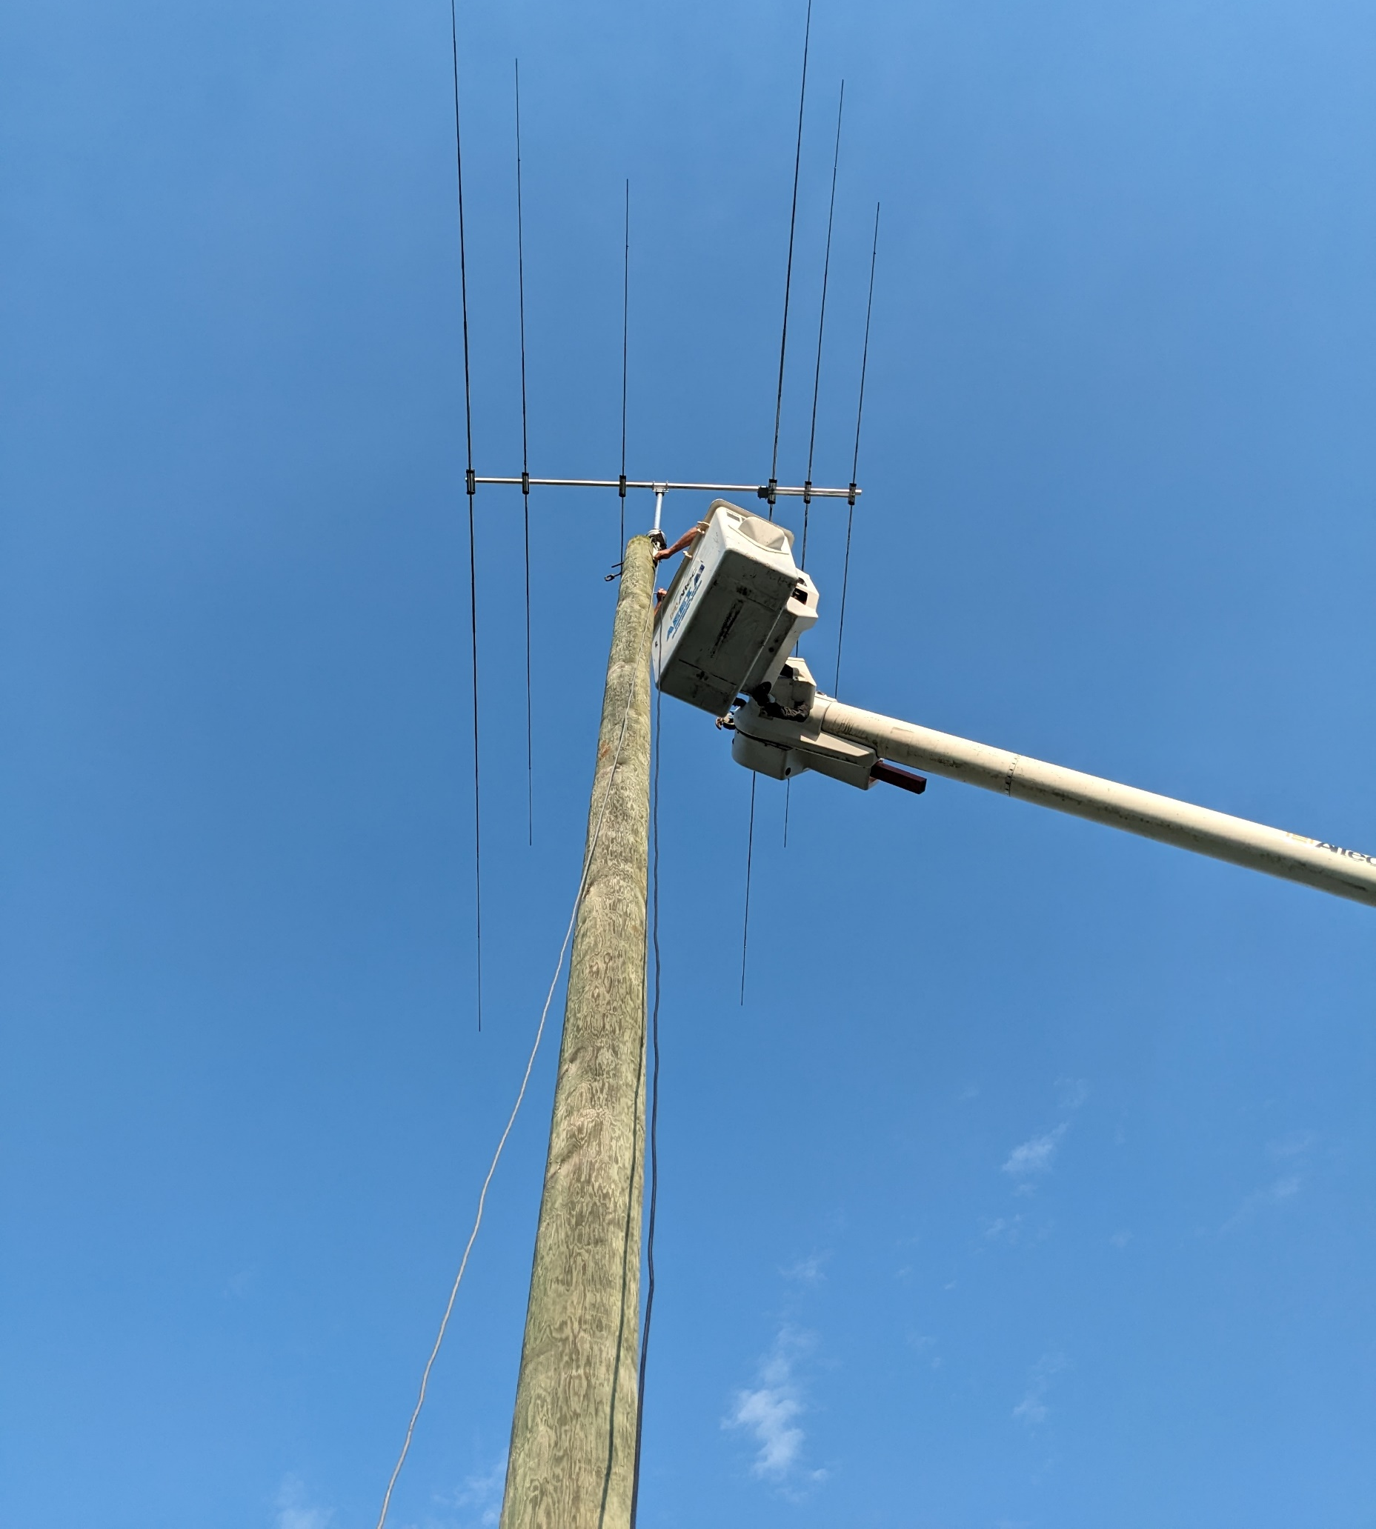
National Jamboree
Unpacking and assembling antennas

Slide 12
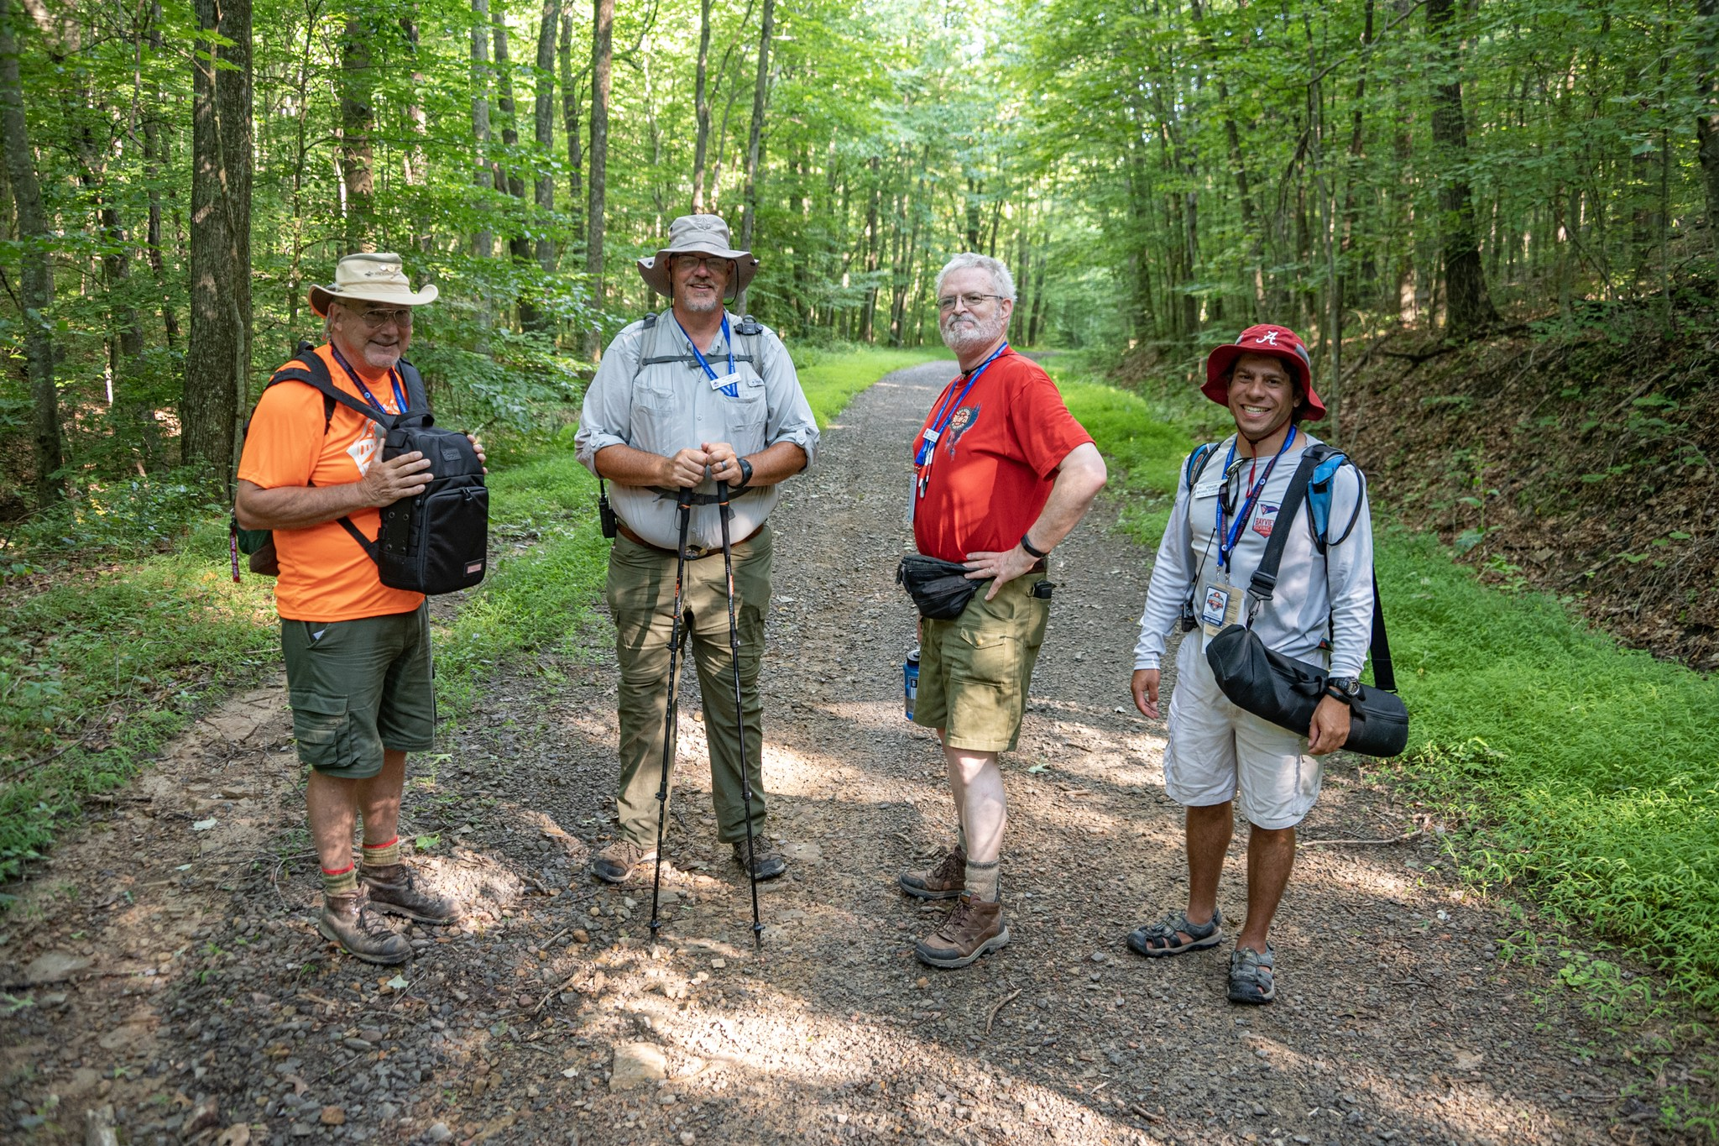
National Jamboree
Radio demos and SOTA activation

Slide 13
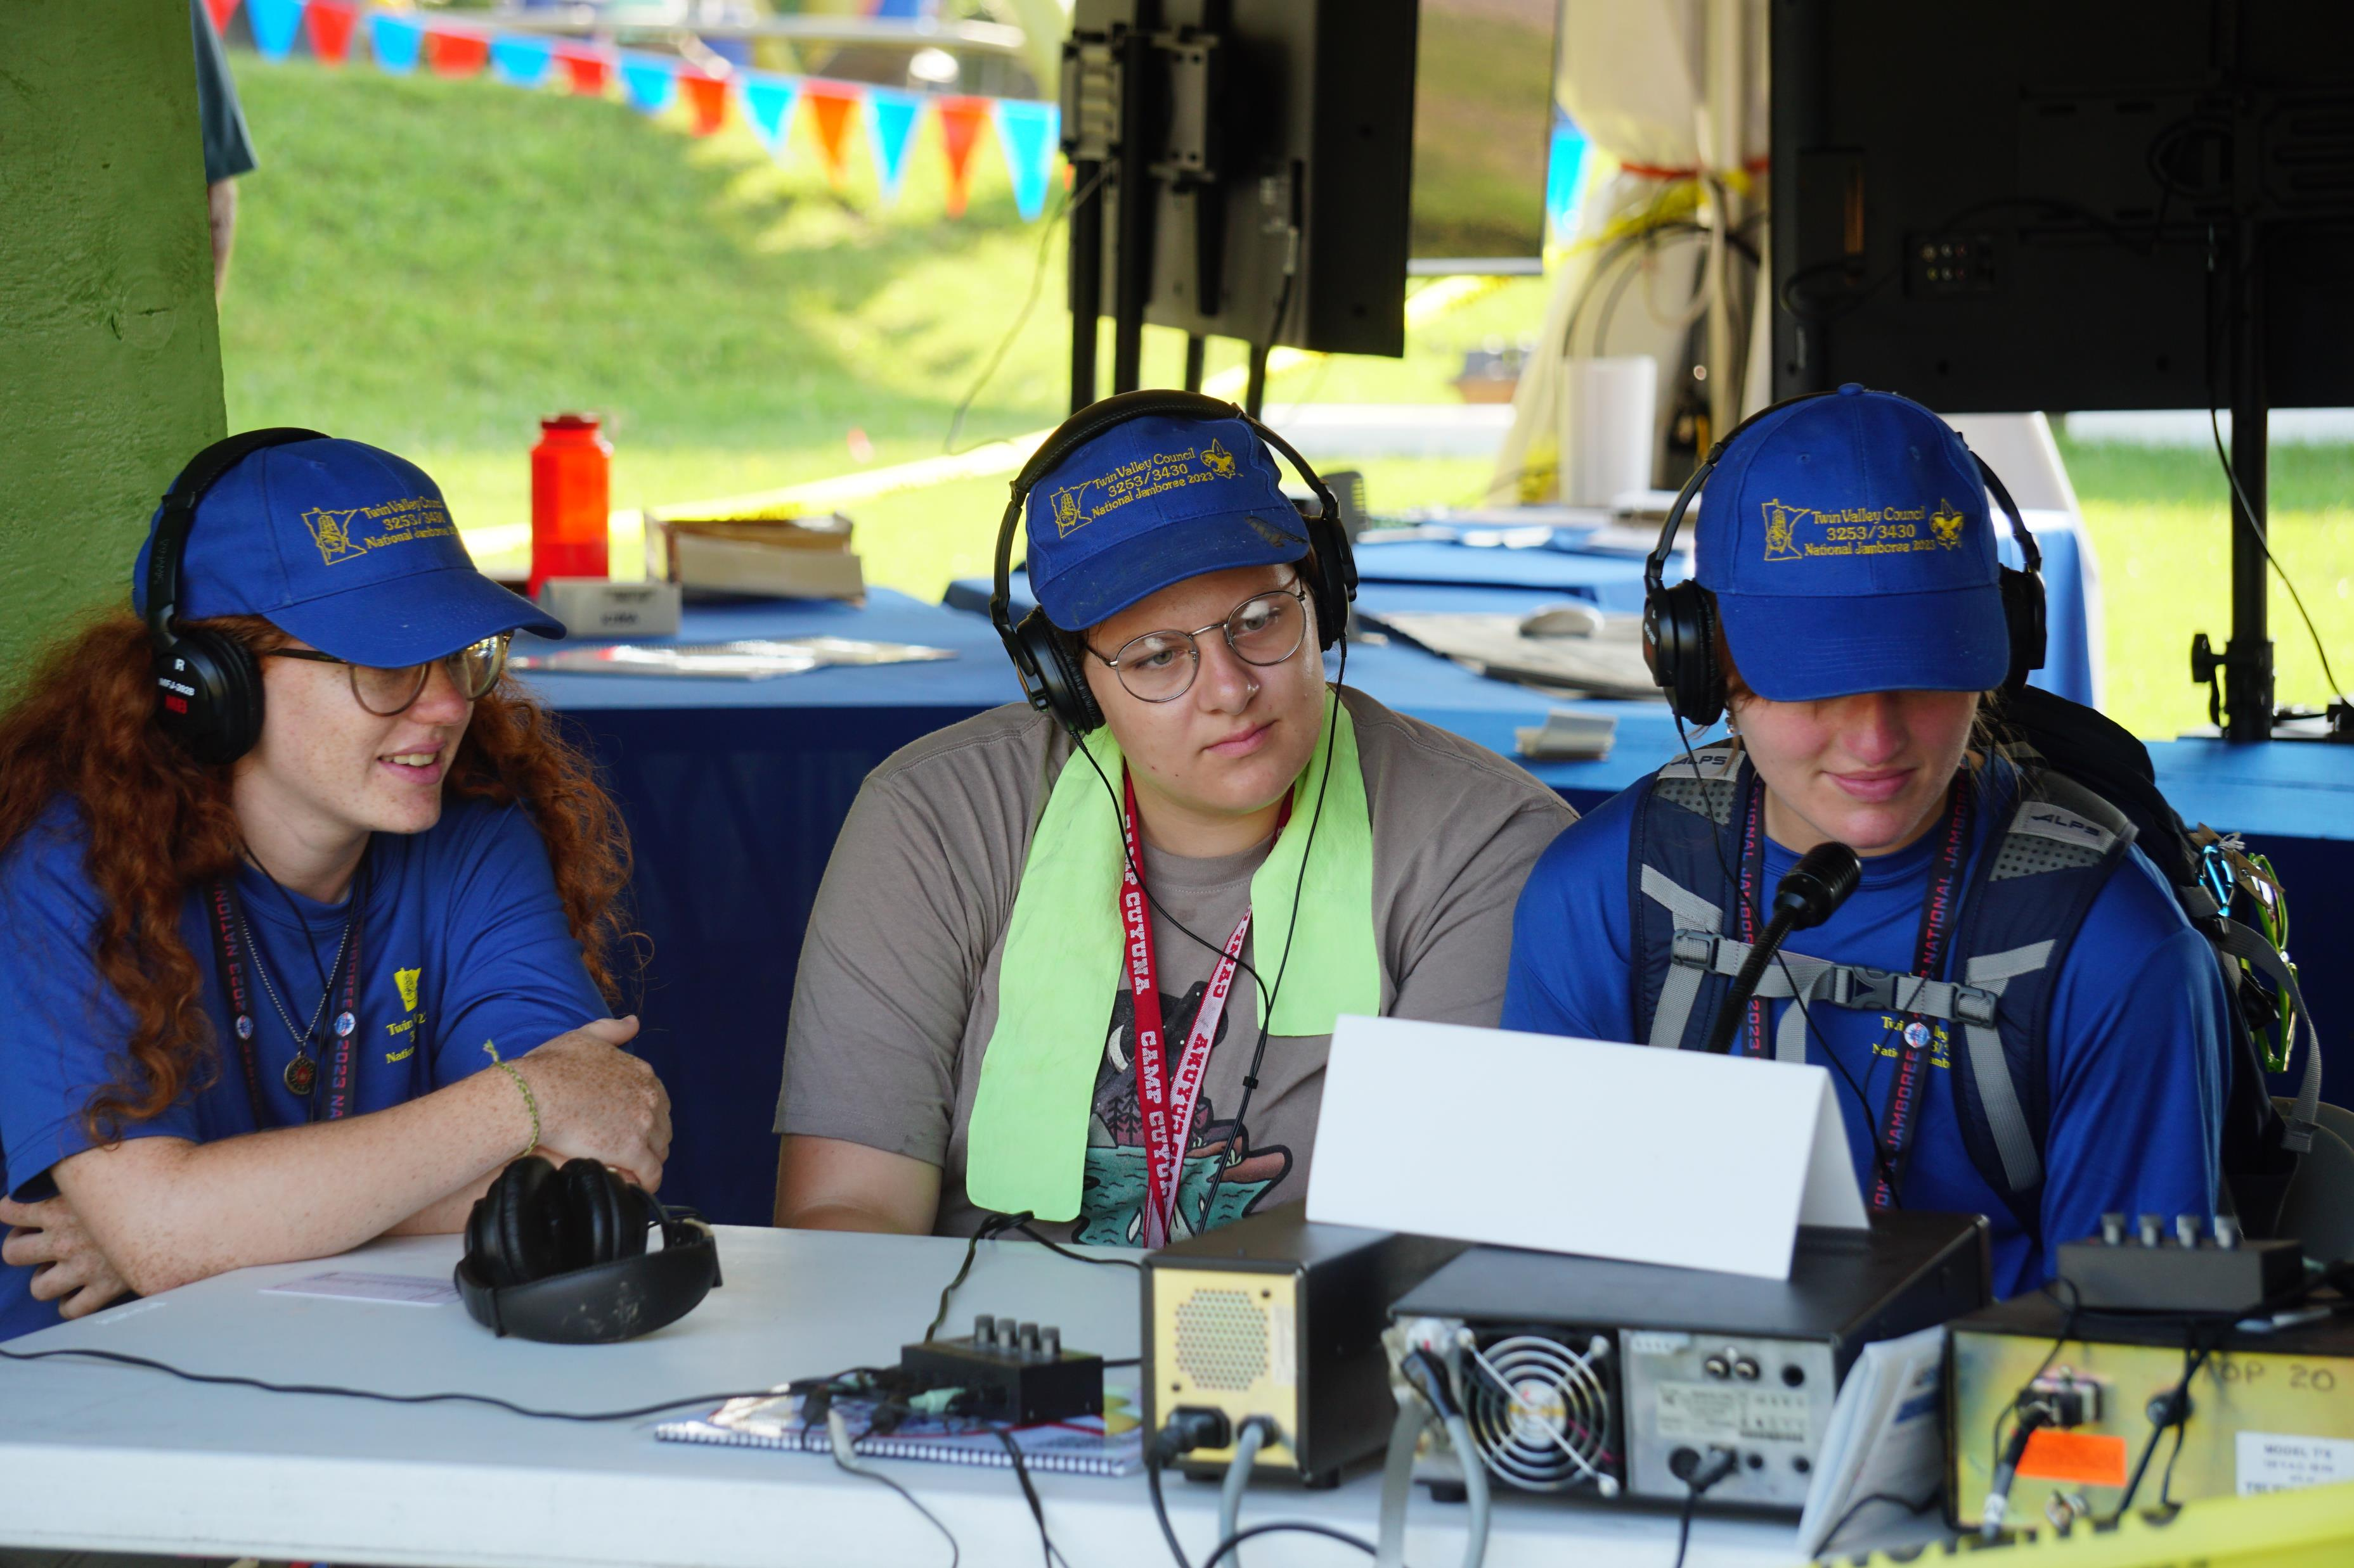
National Jamboree
Radio Demos

Slide 14
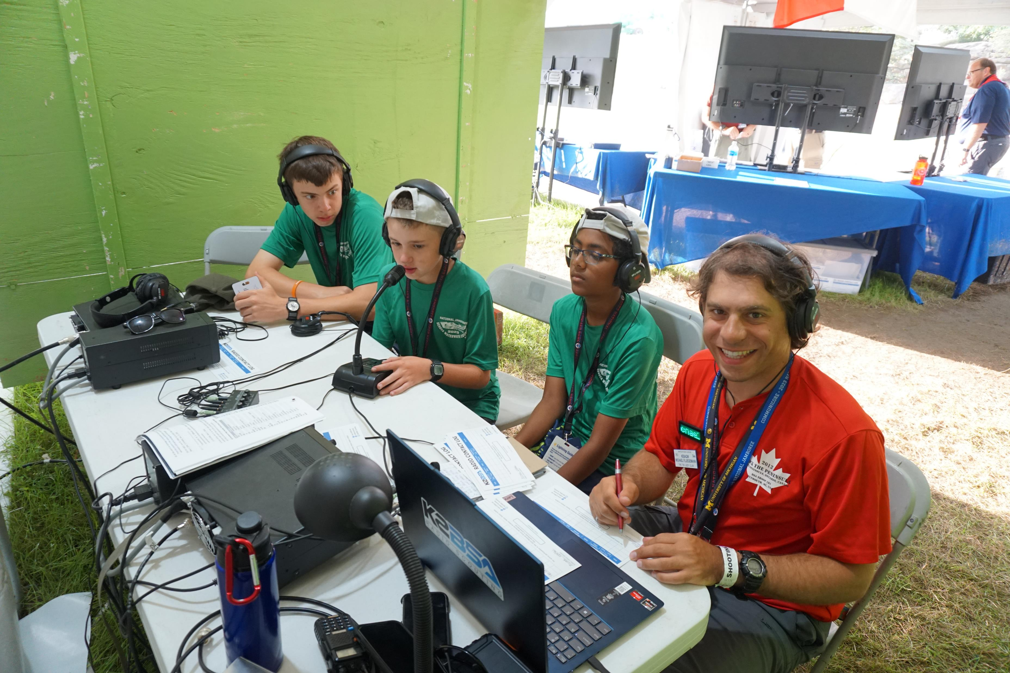
National Jamboree
Radio Demos

Slide 15
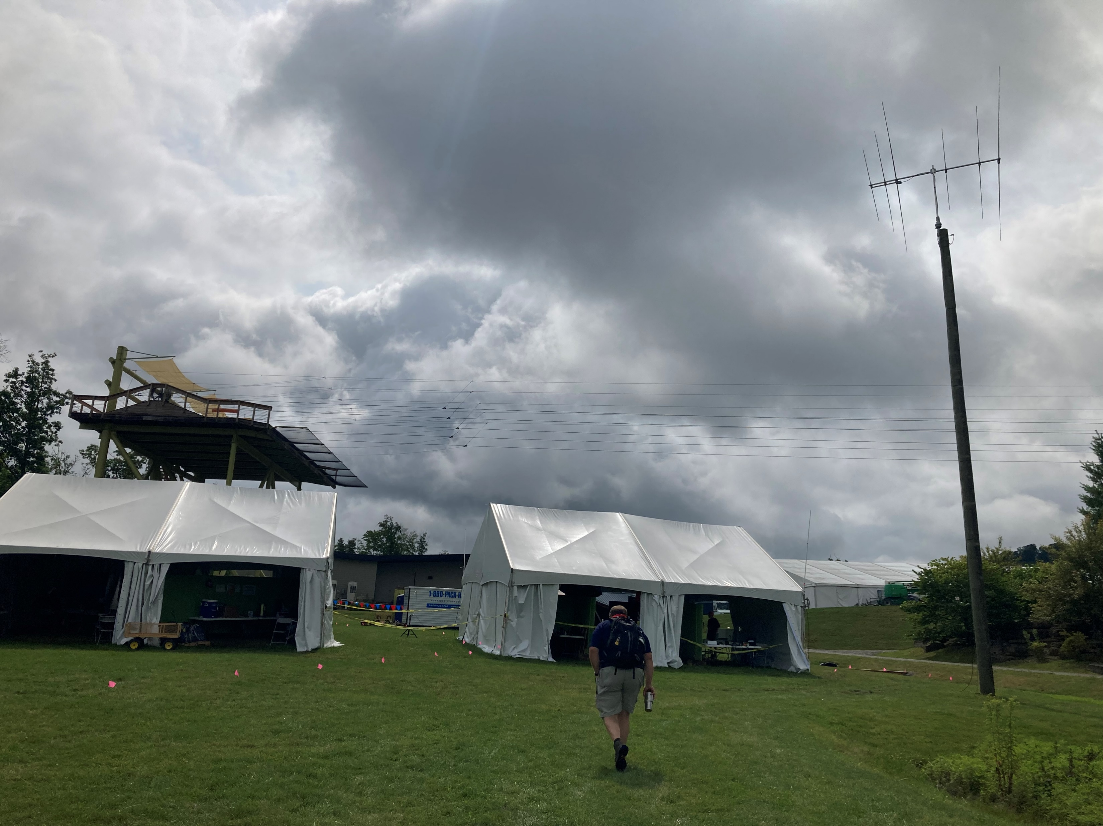
National Jamboree
After hours operating

Slide 16
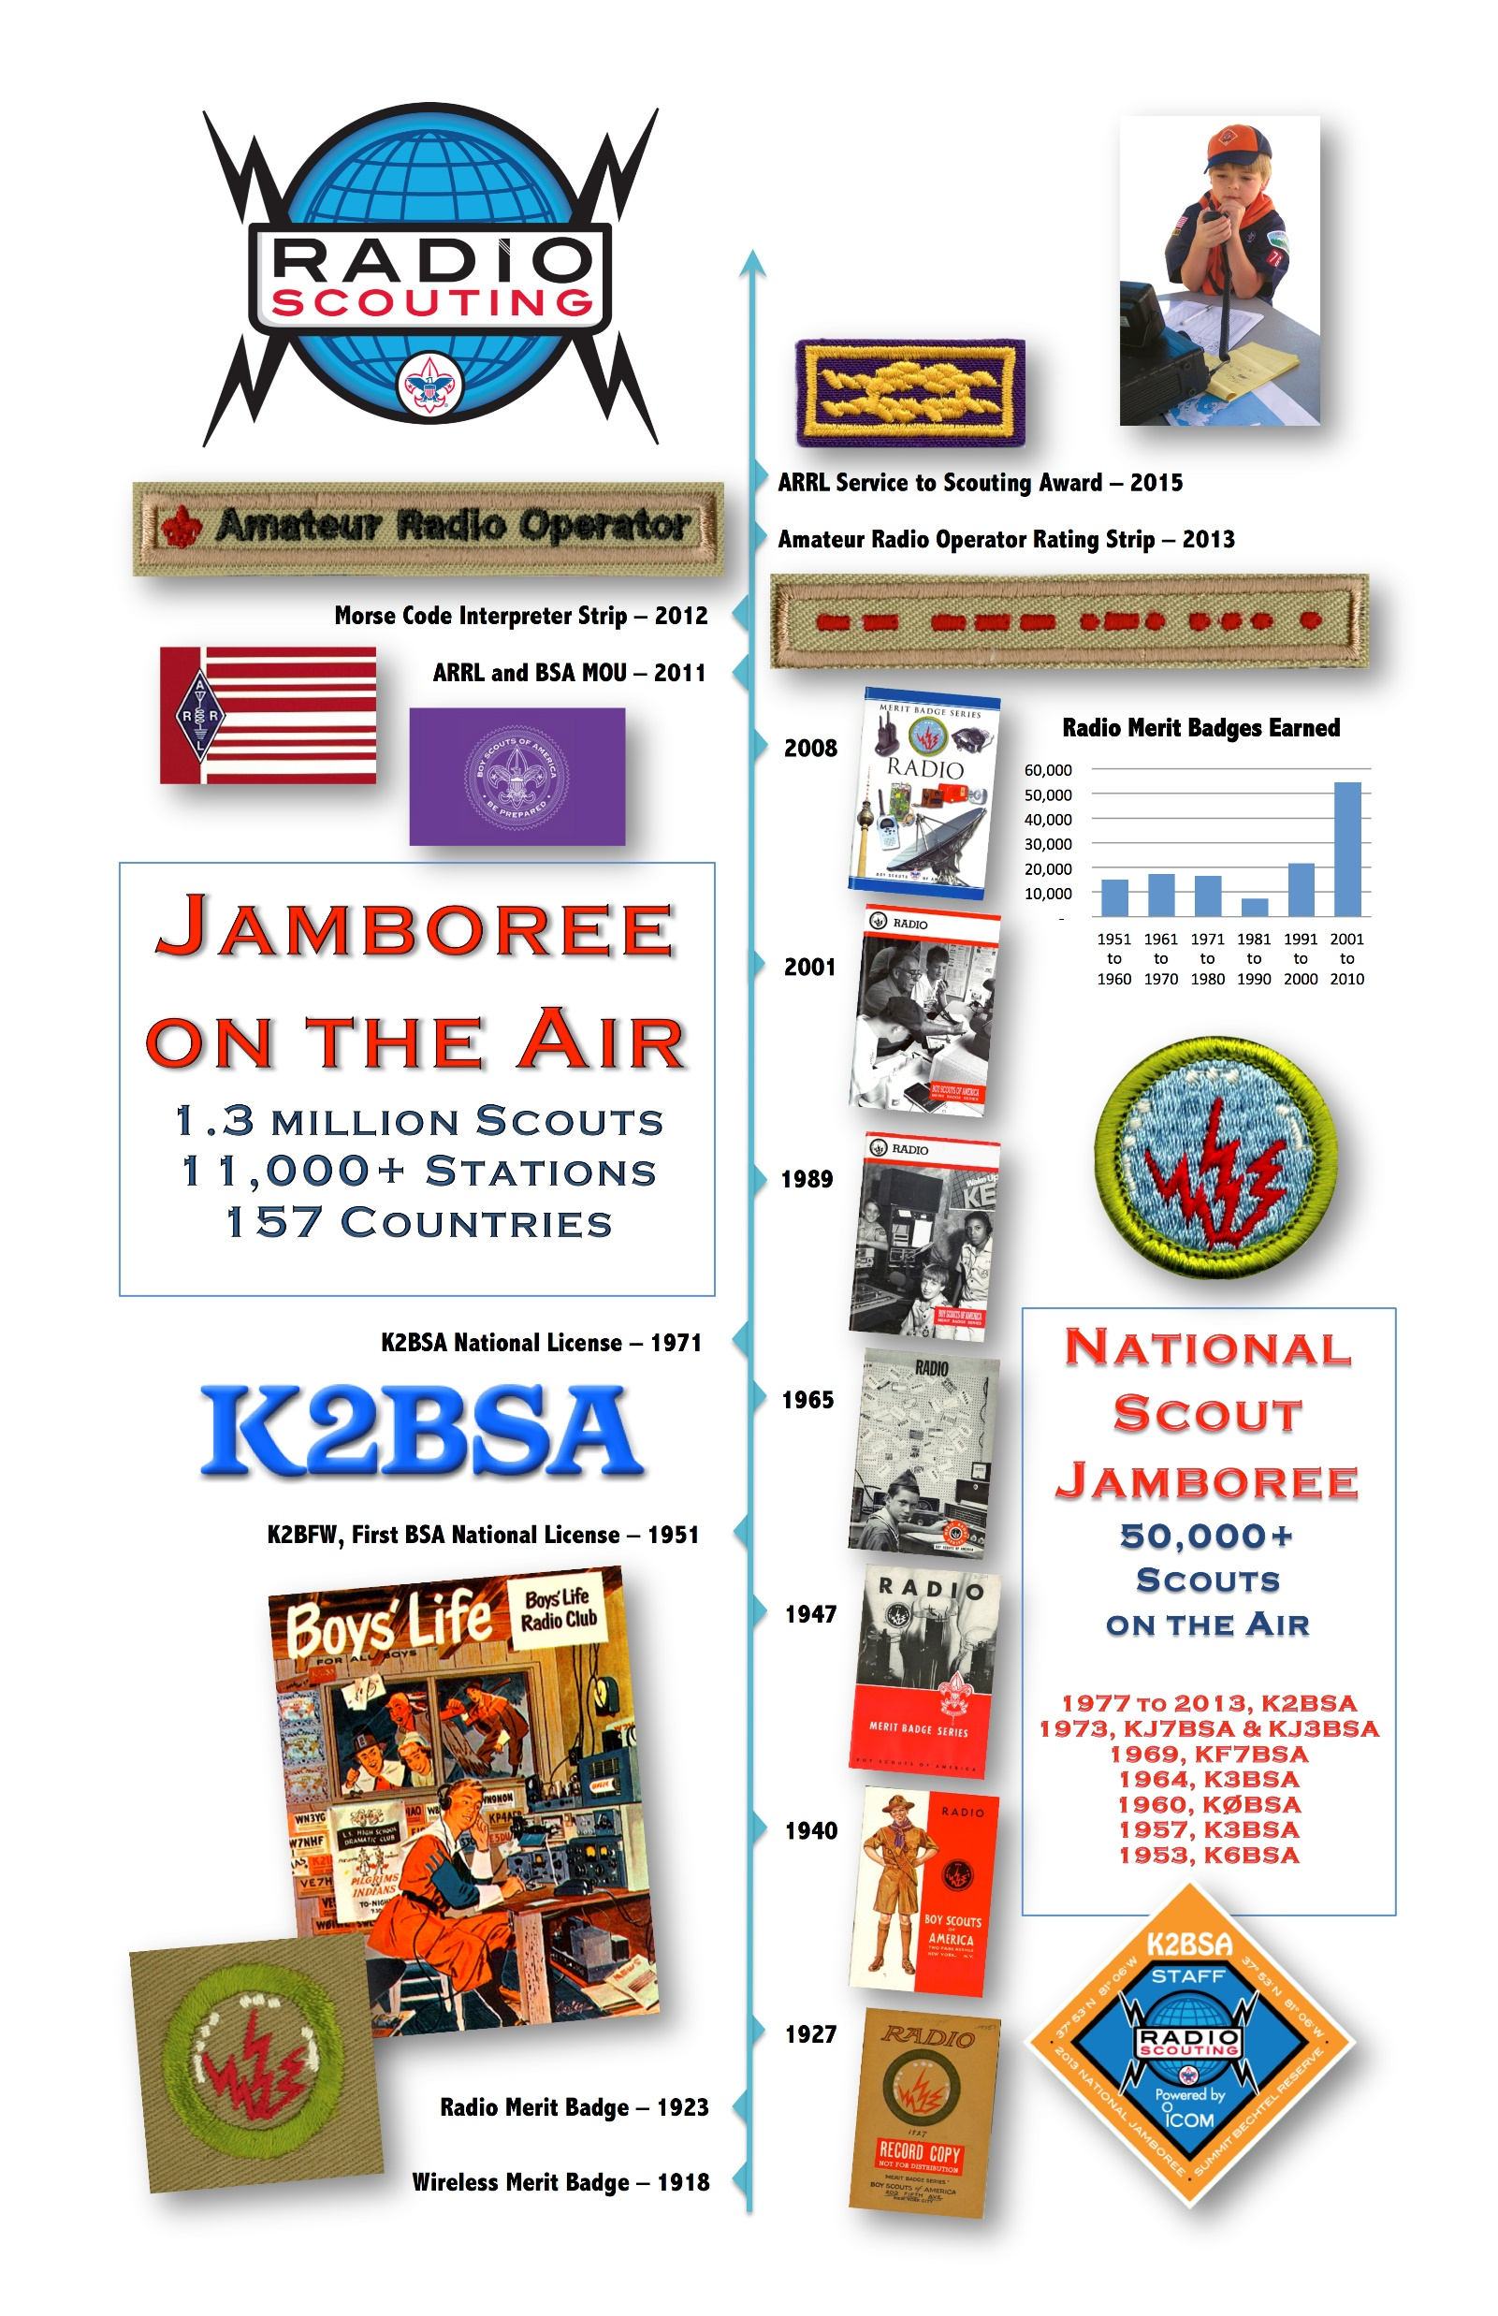

Slide 17
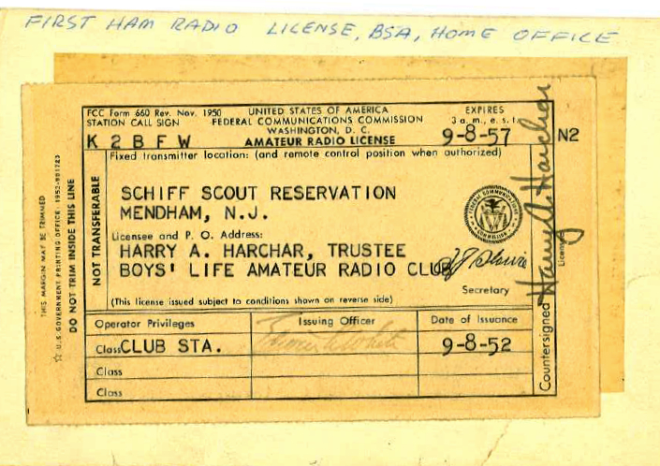
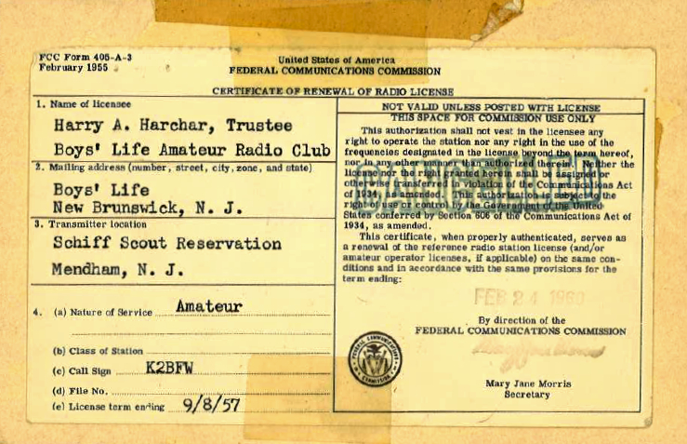
K2BSA
Original Call K2BFW -Boys Life Radio Club – North Brunswick, NJ
Hallicrafters SX-111 receiver, HT-37 transmitter, HT-33 power amplifier, EV-664 microphone from Electro-Voice, Telrex Tower & 3 band beam and rotor.
Hammarlund & Heathkit also donated
K2BSA awarded to National Scout Headquarters in 1971
K2BSA was off the air after the BSA headquarters moved to Dallas in the 90s, but was back on the air in 2000
Notes:
Founded when headquarters moved from NYC to NJ

Slide 18
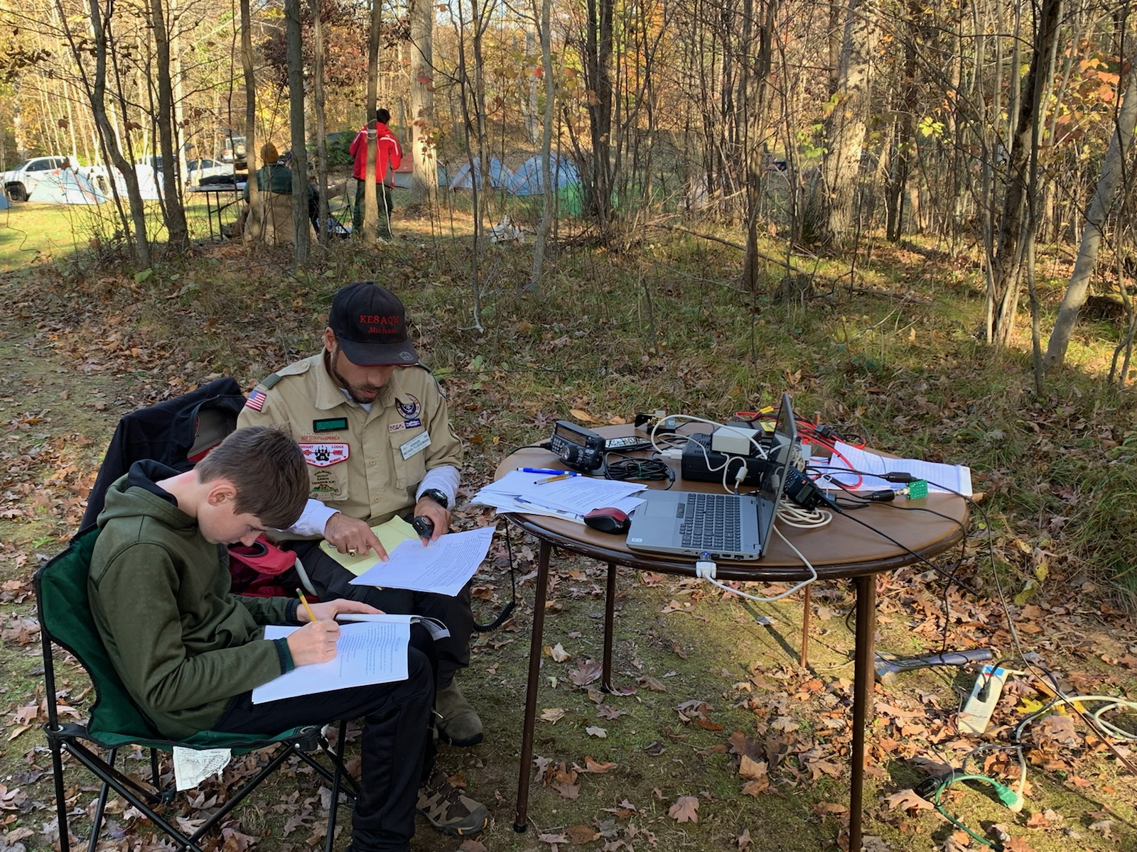
Scout Camps on the Air
https://k2bsa.net/scout-camps-on-the-air/
Awards available for All radio Amateurs
Awards for Scout Camps that have stations
Awards program for Scouts & Scouters operating from a BSA Camp. SCOTA
Points available for Scout Stations not at a BSA camp. SSCOTA
50 points needed, points per contact vary

Slide 19
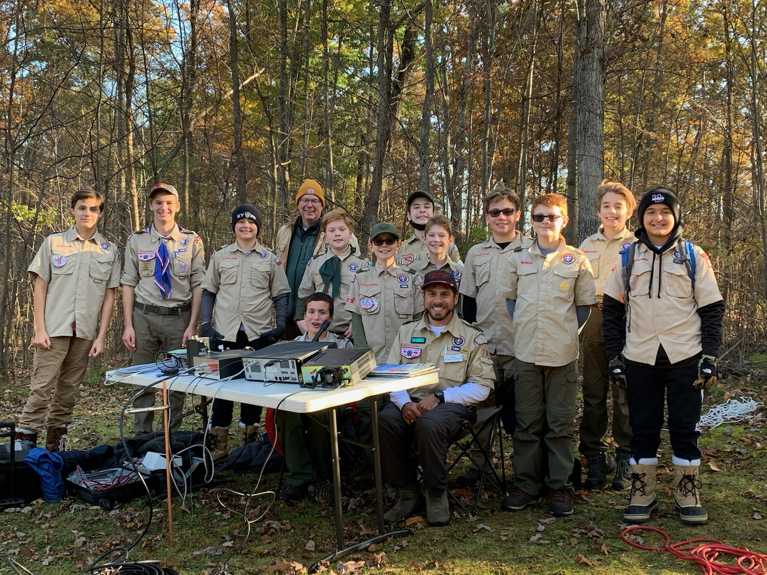
Radio Merit Badge
First created as Wireless Merit Badge 1918
First Radio Merit Badge in 1923
Last year ranked 81/139 and had the largest increase in ranking from 2021
Requirements include:
Learning about radio, propagation, FCC
Visiting a station
A deep dive into one of the following, Ham, SWL, Broadcast or RDF
https://blog.scoutingmagazine.org/2023/02/28/2022-merit-badge-rankings-a-new-chart-topper-emerges/

Slide 20
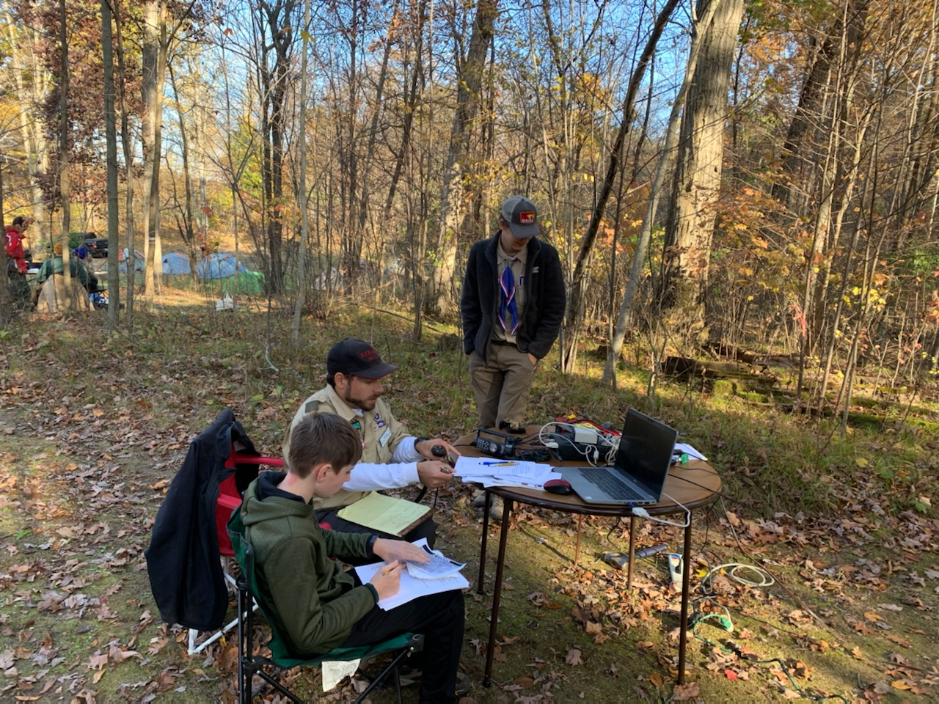
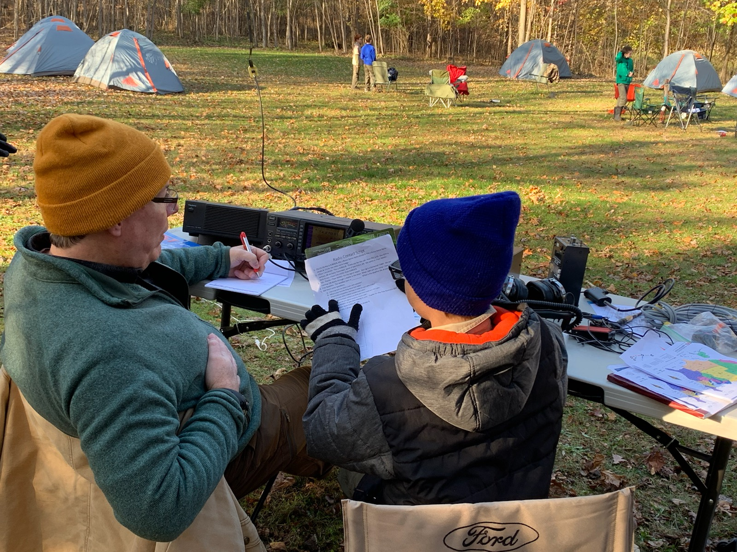
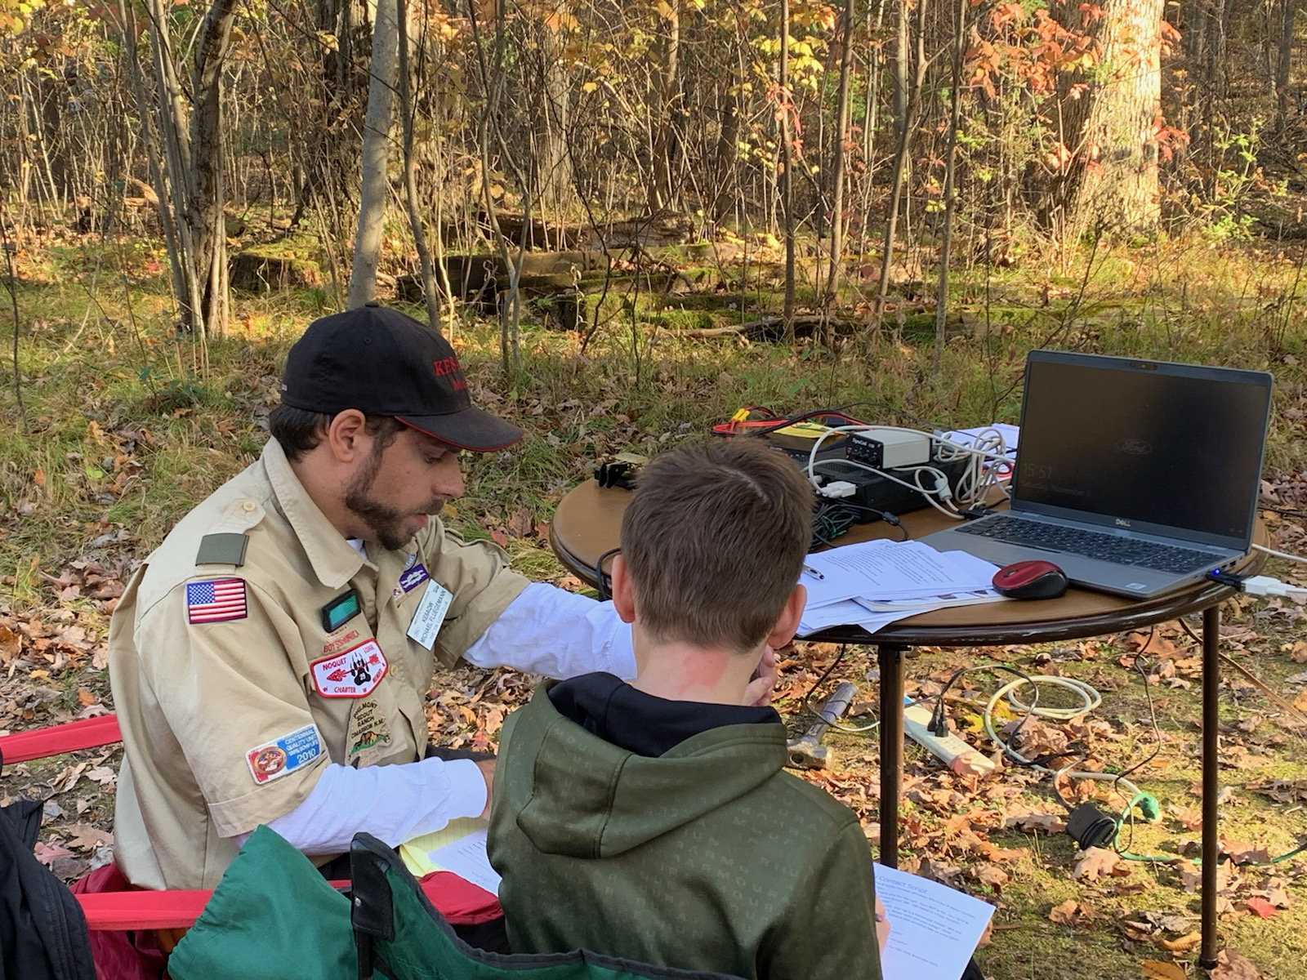
Radio Merit Badge

Slide 21
Uniform
Morse Code Interpreter strip
Amateur Radio Operator Strip
Carry on 5 min conversation
Decode a 2 min message
Send a 25 word document
Minimum 5 wpm proficiency
Any licensed operator can wear this patch on their sleve

Slide 22
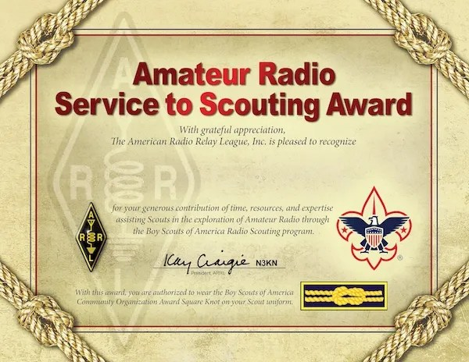
ARRL Service to Scouting Award
https://k2bsa.net/arrl-service-to-scouting-award/
Started in 2014
Recognizes scout leaders who provide a memorable radio experience for scouts
Knot is worn on uniform
Nomination form on ARRL site
Notes:
Organize a class and teach Radio Merit Badge to a District or Council "Merit Badge Day" or "STEM Badge Day" event. 2. Participate in teaching Radio Merit Badge at a Troop, District or Council event on at least three different occasions. 3. Participate in teaching Radio Merit Badge conducted at a hamfest or organized by an amateur radio club on at least three different occasions. 4. Organize and lead a District or Council Jamboree on the Air (JOTA) event. 5. Participate in Jamboree on the Air (JOTA) activities for at least three JOTAs. 6. Provide Amateur Radio communications support for a summer camp, winter camp, Camporee, Klondike Derby, or other official District or Council camp. 7. Participate in three District or Council Camporees by setting up an Amateur Radio Demonstration Station. 8. Serve as Chairman or member of a Council Radio Scouting Committee and guide significant improvements in council amateur radio operating facilities and expanded Scouting amateur radio activities; 9. Arrange for the donation of equipment to establish amateur radio stations at a Council camps. 10. Serve as a K2BSA Staff Member at a National Jamboree or on the Amateur Radio Staff at a World Jamboree

Slide 23
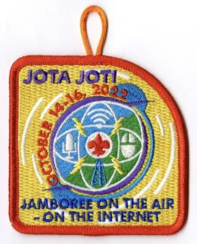
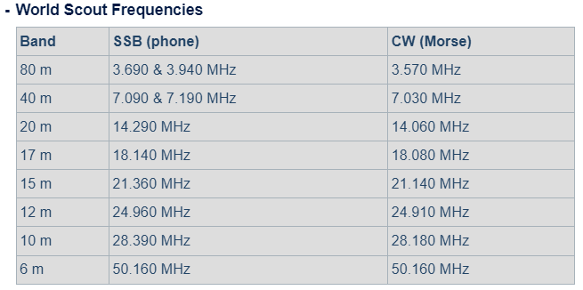
Jamboree on the Air
3rd full weekend in October
Largest international scouting event
Echolink: JOTA 365, WV2BSA
DMR: 33A
This year October 21-22
D-A Scout Ranch 10 am – 4 pm
Sunday 9 am – 1 pm merit badge

Slide 24
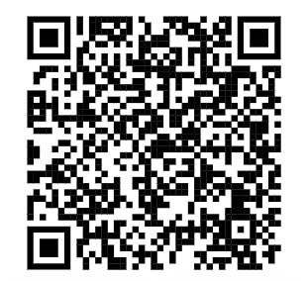
How you can get involved?
BSA Adult Application
Merit Badge Counselor
Engineering, Chemistry, Radio, Digital Technology, Electronics, Programming, Robotics, etc
Unit Leader
Cub Scouts, Scouts BSA, Venturing, Sea Scouts
Beascout.org
District or Council level
Commissioner
Committee member
https://michiganscouting.org/volunteer/
https://filestore.scouting.org/filestore/pdf/524-501.pdf
https://filestore.scouting.org/filestore/pdf/34405.pdf
Merit Badge Counselor Application

Slide 25
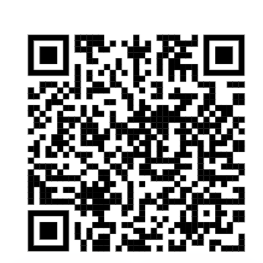
How you can get involved?
Eagle Scout Alumni Link
https://michiganscouting.org/eaglealumni/
Monthly networking & volunteer opportunities
Host annual Eagle Scout Award Recognition Dinner
Assist with Eagle Scout Board of Reviews

Slide 26
How you can get involved? JOTA
Volunteer
Need 10 volunteers to run event
Will include 2-3 HF, & 1 VHF/Echolink or DMR
Fox Hunt
Merit Badge on Sunday
Donate
Would like to raise $400
$3.49/patch
$50 for a stack of QSL cards
Equipment for stations/fox hunt

Slide 27
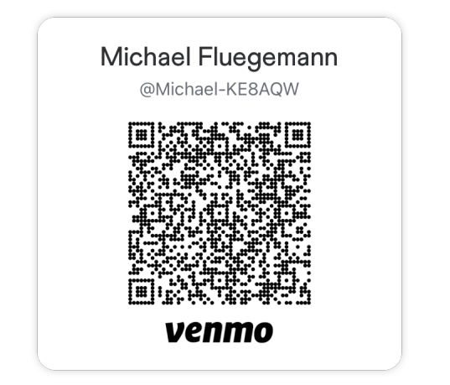
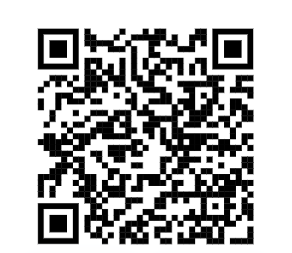
Thank you
Photos were used with permission from K2BSA Jamboree Media Lead
Email me for more information: ke8aqw@arrl.net
Zelle: 734-751-5513
PayPal: paypal.me/MichaelFluegemann
PayPal

